Slide 1

APTECH
Metro star gate

Slide 2

RAXA
saqib
RAXA

Slide 3

SAQIB
Metro star

Slide 4

WEAP
AK M 88 BAREL

Slide 5

HAMMER
JACK

Slide 6
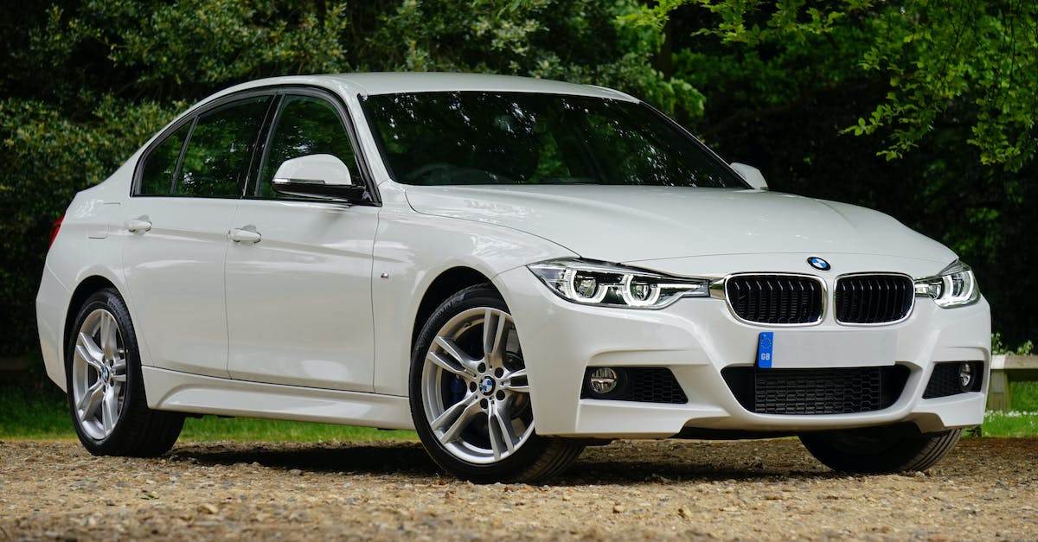
US WP
G LOCK 17

Slide 7
raxa
saqib

